Slide 1
UNIT-5 Windows OS and Windows Server Architecture
OPERATING SYSTEM CONCEPTS
UNIT-5
Windows OS and Windows Server
Architecture

Slide 2
Windows OS and Windows Server Architecture
Windows is a series of operating systems developed by Microsoft. Each version of Windows includes a graphical user interface, with a desktop that allows users to view files and folders in windows.
For the past two decades, Windows has been the most widely used operating system for personal computers PCs

Slide 3
Windows OS and Windows Server Architecture
The server has a broader scope than the operating system. The server handles the administrative group-related activities on a network.
It basically stores, recover and send the files to all the devices that are connected to the network of that server.
Windows Server is a server operating system that enables a computer to handle network roles such as print server, domain controller, web server, and file server.
As a server operating system, it is also the platform for separately acquired server applications such as Exchange Server or SQL Server.

Slide 4
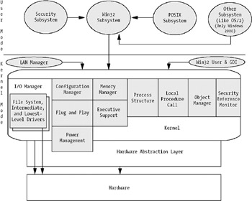
Windows Server Architecture

Slide 5
INTRODUCTION TO WINDOWS OS
The Windows operating system (Windows OS) refers to a family of operating systems developed by Microsoft Corporation. We look at the history of Windows OS from 1985 to present day.
The Windows operating system (Windows OS) for desktop PCs is more formally called Microsoft Windows and is actually a family of operating systems for personal computers. Windows has traditionally dominated the personal computer world, running, by some estimates, more than 75 percent of all personal computers. Beginning in the early 2000s.

Slide 6
INTRODUCTION TO WINDOWS OS
Windows provides a graphical user interface (GUI), virtual memory management, multitasking, and support for many peripheral devices. In addition to Windows operating systems for personal computers, Microsoft also offers operating systems for servers and mobile devices.
An operating system or OS is system software. It provides an interface between computer user and computer hardware. An operating system is used to perform all the basic tasks like file management, process management, memory management, handling input and output devices, and controlling peripheral devices such as disk drives and printers.

Slide 7
Versions of WINDOWS OS
MS-DOS
Windows 1.0 – 2.0
Windows 3.0 3.1
Windows 95
Windows 98
Windows ME – Millennium Edition
Windows NT 31. – 4.0
Windows 2000
Windows XP
Windows Vista
Windows 7
Windows 8
Windows 10
Windows Server
Windows Home Server
Windows CE
Windows Mobile
Windows Phone 7-10

Slide 8
Windows OS Installation
The installation and initial booting of the OS is called the operating system setup. Although it is possible to install an OS over a network from a server or from a local hard drive, the most common installation method for a home or small business is with CDs or DVDs.
https://www.youtube.com/watch?v=YrfdVrbsu-M

Slide 9
Process Management
Process management involves various tasks like creation, scheduling, termination of processes, and a dead lock. ... It is the job of OS to manage all the running processes of the system. It handles operations by performing tasks like process scheduling and such as resource allocation

Slide 10
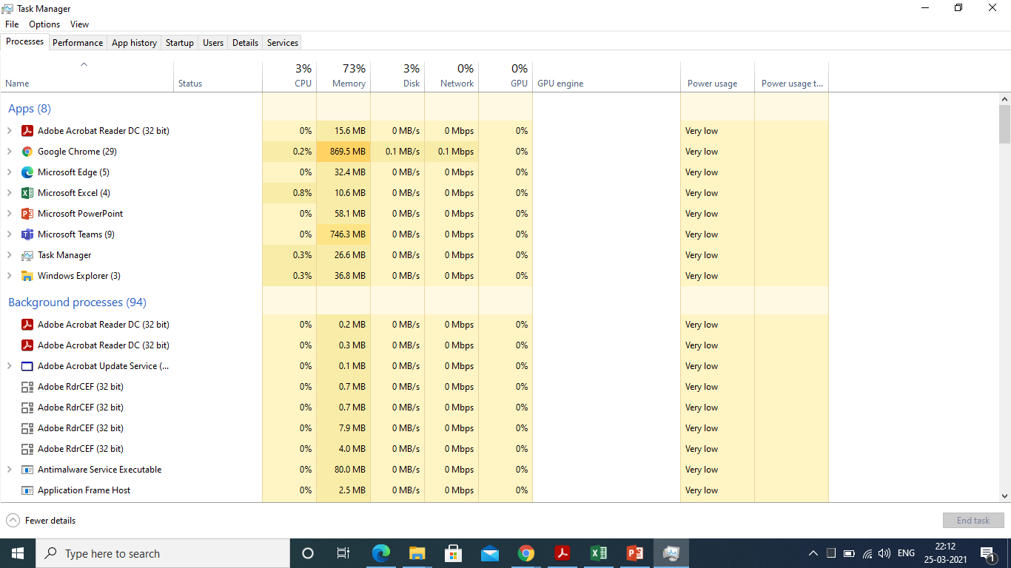
Process Management

Slide 11
Control Panel Overview
The Control Panel is a component of Microsoft Windows that provides the ability to view and change system settings. It consists of a set of applets that include adding or removing hardware and software, controlling user accounts, changing accessibility options, and accessing networking settings.
The control panel is used to configure and manage almost all aspects of Windows, including keyboard and mouse functionality, users and passwords, power options, network settings, desktop background, display settings, sound settings, mouse settings, hardware and software options, installation and removal of programs
https://www.youtube.com/watch?v=gTnP_43PwJw

Slide 12
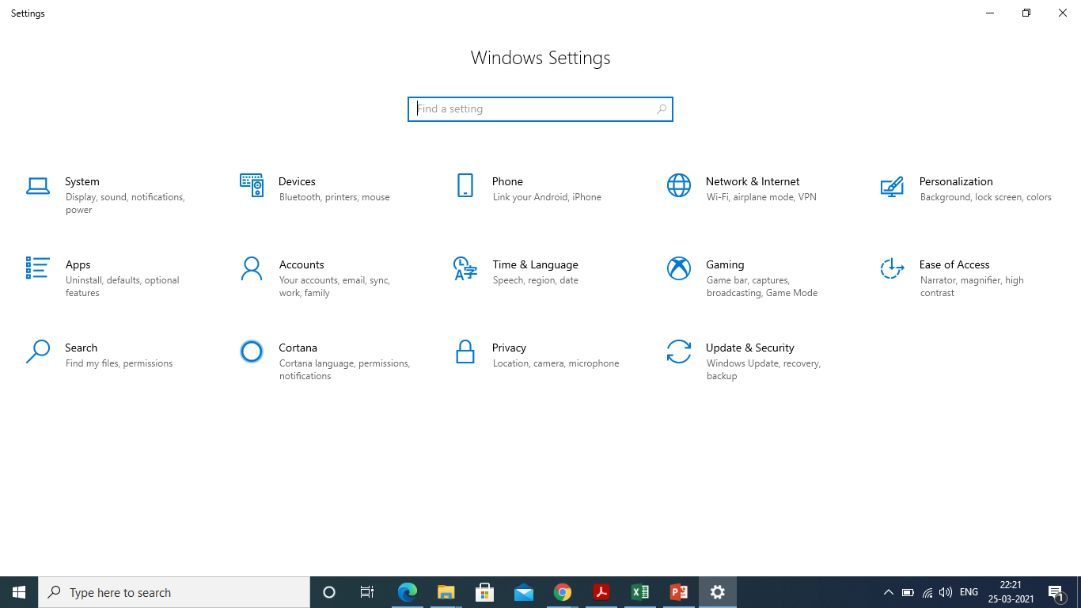
Control Panel Overview

Slide 13
Users, Security and Privacy Settings
On the Start menu, select Settings > Privacy. You'll see a list of general privacy options. There are links to specific privacy settings on the left of the page. For more info, see Windows 10 and privacy.
Select Start > Settings > Update & Security > Windows Security and then Virus & threat protection > Manage settings. (In previous versions of Windows 10, select Virus & threat protection > Virus & threat protection settings.)

Slide 14
Users, Security and Privacy Settings
On the Start menu, select Settings > Privacy. You'll see a list of general privacy options. There are links to specific privacy settings on the left of the page. For more info, see Windows 10 and privacy.
How to Protect Your Privacy on Windows 10
Use a password rather than a PIN for local accounts. ...
You don't have to link your PC with a Microsoft account. ...
Randomize your hardware address on Wi-Fi. ...
Don't automatically connect to open Wi-Fi networks. ...
Disable Cortana to keep voice data private. ...
Watch out for system updates changing your privacy settings.
https://www.youtube.com/watch?v=f-y9kaViAXI

Slide 15
Identify Accessibility Settings
Go to Settings>Ease of Access>Closed Captions and change the settings to your liking. Other Windows 10 accessibility settings you can customize include the caption's transparency, size, style, and effects, though you're limited to only eight colors.
Windows 10 Accessibility Features
Make Windows 10 easier to see. Resize icons, adjust text size and color, customize the mouse cursor, and more—our display and vision settings make it easy to personalize your viewing experience. ...
https://www.youtube.com/watch?v=mFuTT-j5T0U
https://www.microsoft.com/en-us/accessibility/windows?activetab=pivot_1%3aprimaryr2

Slide 16
Service Management in windows 10
On Windows 10, services are programs that run in the background without a user interface and enable system features (such as printing, networking, remote access, File Explorer, Windows Search, updates, etc.) and apps to operate as intended.
To open the Windows Services Manager on your Windows 10 computer, do the following:
Right-click on the Start button to open the WinX Menu.
Select Run.
Type services. msc in the Run box which opens.
Windows Services Manager will open.
https://www.youtube.com/watch?v=IXiXjjcXGmA

Slide 17
Syncing Devices and File Sharing in windows 10
To do this, open the OneDrive System Tray icon and select Settings. At the Settings screen, click the tab for Account and click the button to Choose folders. Check the box to Sync all files and folders in OneDrive, especially if you unchecked any folders previously.
https://www.youtube.com/watch?v=694t8Mi6b74
https://www.youtube.com/watch?v=3-C3v82zOgE

Slide 18
Windows Utilities in windows 10
Utility software is software designed to help to analyze, configure, optimize or maintain a computer. It is used to support the computer infrastructure - in contrast to application software, which is aimed at directly performing tasks that benefit ordinary users.
https://www.youtube.com/watch?v=enzz1xq9ah4
Usefull Windows 10 Utilities
Windows Accessories.
Snipping Tool Options.
Steps Recorder.
Report.
Administrative Tools.
System Information.
Performance Monitor.
Adding Counters.

Slide 19
Thank You
Have a Good Day!

